Slide 2
Objectives
Explain HTML5 semantic tags
Explain HTML5 semantic tag layouts
Explain the usage of navigation bar
Describe a text-based and graphic navigation bar
Explain image mapping
Explain divisions in HTML5

Slide 3
HTML5 Semantic Tags
HTML5 has evolved by introducing new elements that brought semantics to higher level.
Earlier version of HTML had the universal tag div which was used to accomplish various tasks in the HTML structure.
Constraint with div tag is that, it confused the user when multiple div tag was used in large coding.
HTML5 has introduced two types of semantic tags namely, text-level and structural.
Show Image
Notes:
Constraint : hạn chế

Slide 4
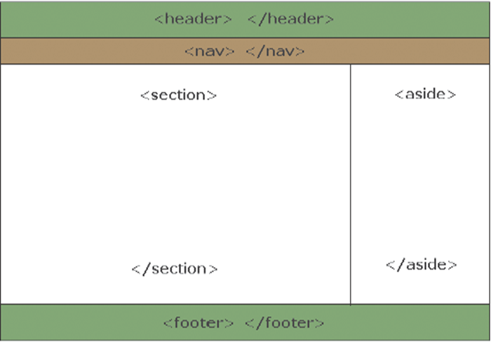
Structural Semantic Tags
Are block level elements and are used to structure pages.
New structural semantic elements are as follows:
Nav
Article
Structural Semantic Tags
Aside
Section
Header
Footer

Slide 5
Text-level Semantic Tags
Are currently inline elements.
New text-level semantic elements are as follows:
Progress
Text-level Semantic Tags
Mark
Meter
Time

Slide 6
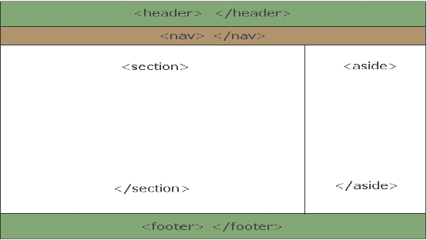
HTML5 Semantic Layout 1-6
<header> element provides introductory information.
<head> tag provides information about the entire document.
<header> tag is used only for the body of the Web page or for the sections inside the body.
<!DOCTYPE html>
<html lang=”en”>
<head>
<meta charset=”utf-8”>
<title>My First Page</title>
</head>
<body>
<header>
<h1>Sample Blog </h1>
</header>
</body
</html>

Slide 7
HTML5 Semantic Layout 2-6
nav element is a section which contains the navigation link to other pages or links to different sections within the page.
Navigational elements are helpful in identifying large blocks of navigational data.
<body>
<header>
<h1>Sample Blog</h1>
</header>
<nav>
<ul>
<li> home </li>
<li> help </li>
<li> contact </li>
</ul>
</nav>
</body>
Notes:
Navigation link : lien ket dieu huong

Slide 8
HTML5 Semantic Layout 3-6
<section> is the main information bar that contains the most important information of the document.
It can be created in different formats. For example, it can be divided into several blocks or columns.
<body>
<header>
<h1>Sample Blog </h1>
</header>
<nav>
<ul>
<li> home </li>
<li> help </li>
<li> contact </li>
</ul>
</nav>
^{<section>}
^{<h1>Links</h1>}
^{<ul>}
<li><a href=”#”>Link 1</a></li>
<li><a href=”#”>Link 2</a></li>
<li><a href=”#”>Link 3</a></li>
^{</ul>}
^{</section>}
^{</body>}

Slide 9
HTML5 Semantic Layout 4-6
<aside> element is a column or a section that generally contains data linked to the main information.
This element is used for typographical effects, such as for sidebars, for groups of nav elements, for advertising purposes, and so on.
<!DOCTYPE html>
<html lang=”en”>
<body>
<header>
<h1>Sample Blog </h1>
</header>
<nav>
<ul>
<li> home </li>
<li> help </li>
<li> contact </li>
</ul>
</nav>
<section>
<h1>Links</h1>
<ul>
<li><a href=”#”>Link 1</a></li>
<li><a href=”#”>Link 2</a></li>
<li><a href=”#”>Link 3</a></li>
</ul>
</section>
<aside>
<blockquote>Archive Number One</blockquote>
<br>
<blockquote>Archive Number Two</blockquote>
</aside>
</body>
</html>

Slide 10
HTML5 Semantic Layout 5-6
The Code Snippet demonstrates the use of <footer> tag.
<body>
<header>
<h1>Sample Blog</h1>
</header>
<nav>
<ul>
<li> home </li>
<li> help </li>
<li> contact </li>
</ul>
</nav>
<section>
<h1>Links</h1>
<ul>
<li><a href=”#”>Link 1</a></li>
<li><a href=”#”>Link 2</a></li>
<li><a href=”#”>Link 3</a></li>
</ul>
</section>
<aside>
<blockquote>Archive Number One</blockquote>
<br>
<blockquote>Archive Number Two</blockquote>
</aside>
<footer>
Copyright &copy; 2012-2013
</footer>
</body>
</html>

Slide 11
HTML5 Semantic Layout 6-6
<article> element helps to insert a self-contained composition in an application, page, document, or site.
<body>
<header>
<h1>Sample Blog</h1>
</header>
<nav>
<ul>
<li> home </li>
<li> help </li>
<li> contact </li>
</ul>
</nav>
<section>
<article>
First Blog entry
</article>
<article>
Second Blog entry
</article>
</section>
<aside>
<blockquote>Archive Number 1</blockquote>
<br>
<blockquote>Archive Number 2</blockquote>
</aside>
<footer>
Copyright &copy; 2012-2013
</footer>
</body>
</html>

Slide 12
Navigation Bar
Is one of the most important elements in Web design.
Web-layouts do not have any specific physical representation except for a consistent navigation menu.
In Web designing, navigation menu are always on navigation bars, which can be horizontal or vertical.
Navigation bar is a section of a Website or online page intended to support visitors in browsing through the online document.
Web pages will have a primary and a secondary navigation bar on all pages which will include links to the most important sections of the site.
Advantage of using a text-based navigation bar is that it reduces the loading time of a page.

Slide 13
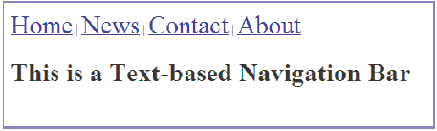
Text-based Navigation Bar
The Code Snippet demonstrates the HTML code for a text-based navigation bar.
<!DOCTYPE html>
<html>
<head>
</head>
<body>
<nav>
<a href=”/home/”><font size=”6”>Home</font></a> |
<a href=”/news/”><font size=”6”>News</font></a> |
<a href=”/contact/”><font size=”6”>Contact</font></a> |
<a href=”/about/”><font size=”6”>About</font></a>
</nav>
<h1>This is a Text-based Navigation Bar</h1>
</body>
</html>

Slide 14
Graphical Navigation Bar with Rollover Effects
Similar to the graphical navigation bar except for additional feature.
Moving the mouse over the linked image leads to a change in the state of image.
State change of image leads to an image swapping process.
When the mouse is moved off the image, the image swaps back to the previous view.
This rollover effect creates an interactive activity between the Web site and the visitor.
Rollover effect has two different activities that include the image in the original view and the changed image after mouse rollover.

Slide 15
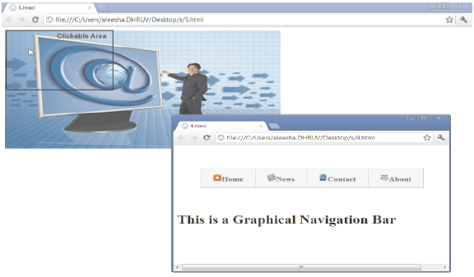
Image Map
Are images with clickable areas linked to another page
Be Defined by using the <map> tag
<map> element contains a number of <area> elements for defining the clickable areas in the image map.
The id attribute of the <map> tag when specified, must have the same value as the name attribute.
<img src=”6.jpg” width=”600” height=”300” alt=”cake” usemap=”#cakemap” />
<map name=”cakemap”>
<area shape=”circle” coords=”0,0,200,600” href=”4.html” alt=”cake” />
</map>

Slide 16
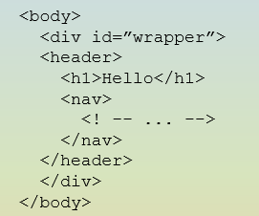

Divisions 1-2
<div> tag defines a division in an HTML Web page.
Is used to group block-elements and format them with CSS.
New structural semantic tags reasonably reduce a lot of <div> tag’s usage.
can be used when there is no other semantically appropriate element left that suits the purpose in a Web page development.
It can be commonly used for stylistic purposes such as wrapping some semantically marked-up content in a CSS-styled container.

Slide 17
Division Positioning and Formatting 1-2
Elements can be positioned using the top, bottom, left, and right properties.
These properties will not work unless the position of the property is set.
There are five position properties in DIV elements namely, static, relative, absolute, fixed, and inherit.
Only three properties are used namely, absolute, relative, and fixed.
Positioning can be applied to any block element.
Default position for a block element (DIV) is static.

Slide 18
Summary
HTML 5 has introduced two types of semantic tags. They are namely, text-level and structural.
Structural semantic tags : Section, Header , Footer , Aside, Nav, Article
Text level semantic tags : Mark, Time, Meter, Progress
Navigation is the most significant element in Web design. Since Web-layouts does not have any physical representation, a user can depend on consistent navigation menu.
Text-based navigation bars are created as stand-alone navigation bars that are not associated with icons. Text-based navigation bar is easy to create and can be displayed in any Web browsers.
Graphical navigation bar is better than text-based navigation as it gives a visual appeal to the visiting users.
The new structural semantic tags reasonably capture a lot of <div>‘s territory, but <div> tag still has a place in the HTML5 world. Div can be used when there is no other semantically appropriate element left that suits the purpose in a Web page development.

Slide 19
